Slide 1
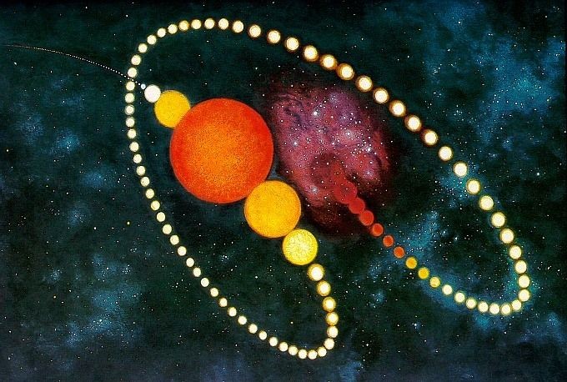
Birth and Death of Stars
Prof .Dr.K.Ravikumar

Slide 2
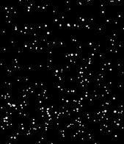
What is a star
A star is a massive, luminous ball of burning gas. held together by gravity. The nearest star to Earth is the Sun.

Slide 3
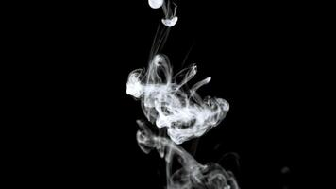
How does a gas have a spherical shape?
Burning gas held together by gravity

Slide 4
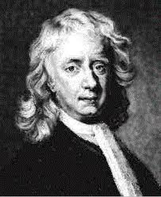
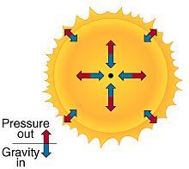
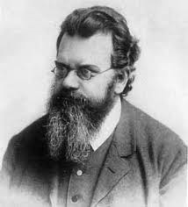

Slide 5
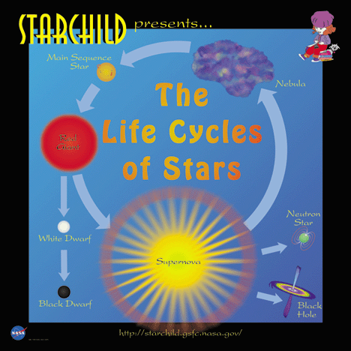
Life span of the star
1.Nebula -Photo star – star formation
2.Main sequence star ( sun)
3.Red giant
4.White dwarf
5.Super nova ( new star)
6.Neutron star
7.Black hole

Slide 6
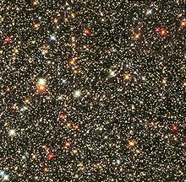
*.gravitational collapse of a giant molecular cloud (GMC). *GMC size 100 light-years (9.5×10¹⁴ km) * Mass up 60,00,000solarmasses(1×10³⁷kg). *As its temperature and pressure increase, a fragment condenses into a rotating sphere of superhot gas known as a protostars. *Protostars with masses less than roughly 0.08 M⊙ (1.6×10²⁹ kg) never reach temperatures high enough for nuclear fusion of hydrogen to begin.
1.NEBULA

Slide 7
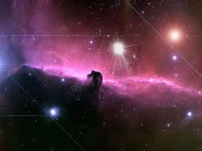
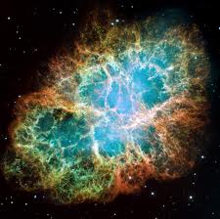
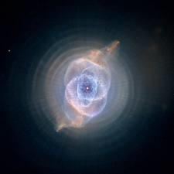
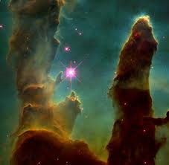
Nebulas-photos

Slide 8
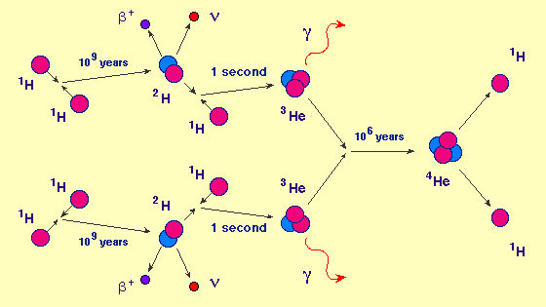
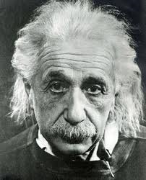
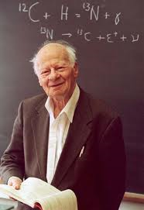
Energy production

Slide 9
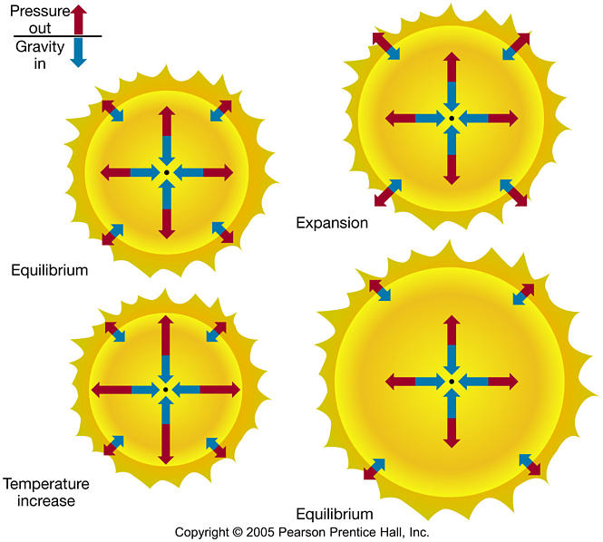
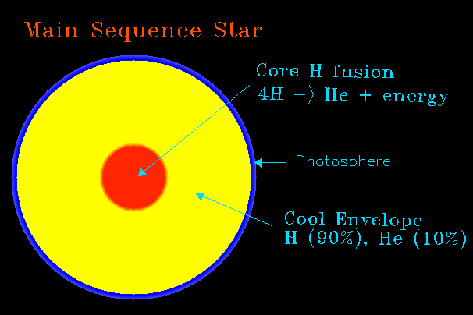
2.Main sequence star
F_{G} = P_{g}

Slide 10
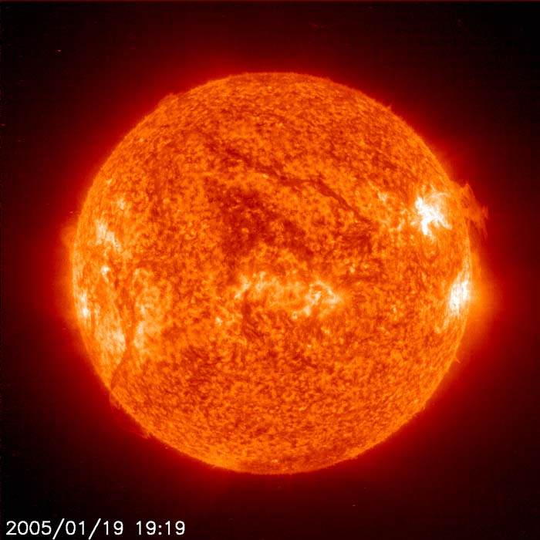
Main sequence star- sun

Slide 11
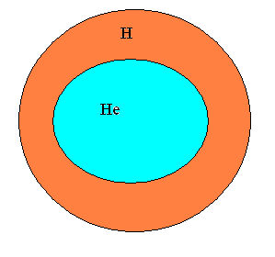
3.Red giant
What is happen if all hydrogen is totally exhausted ?

Slide 12
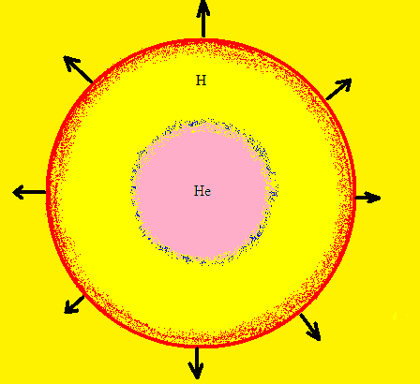
P_{g} > F_{G}
STAR STARTS TO EXPANDS

Slide 13
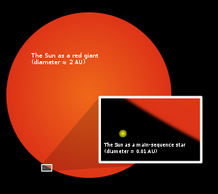
Red giant
The Sun become a red giant after 5billion year
radius will expand to 200 times
The Sun will lose a significant fraction of its mass.
Surface temperature is low 5000K

Slide 14
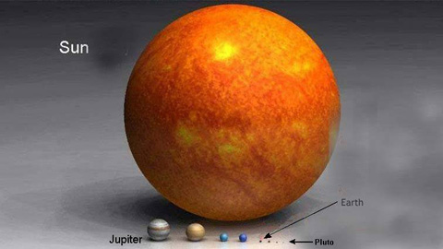
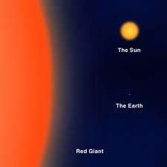
Red giant-solar system

Slide 15
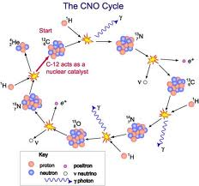
4.White dwarf
F_{G} >P _{g}
STAR STARTS TO CONTRACTS
*A white dwarf is small star composed mostly of electron.
*They are very dense (10⁹ Kg/m³ )
*white dwarf's mass is equal to of the Sun ( M < 1.4M₀).
* Radius 1000 times smaller the sun
*Temperatures 7000K

Slide 16
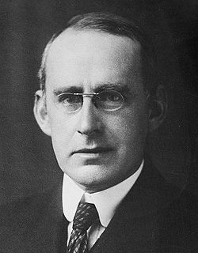
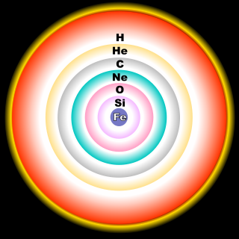
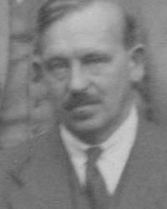

Slide 17
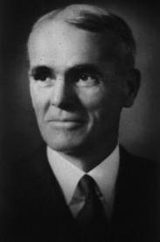
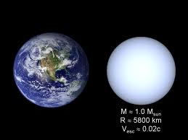
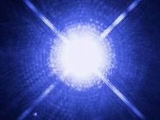
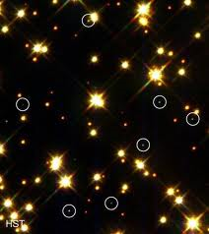
White dwarf -photos

Slide 18
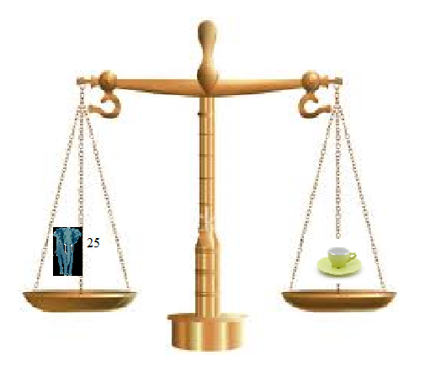
White dwarf materials

Slide 19
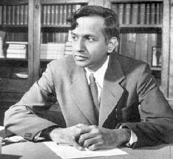
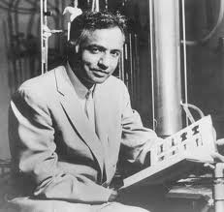
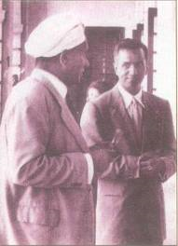

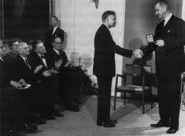
White dwarf is the end stage of star?

Slide 20
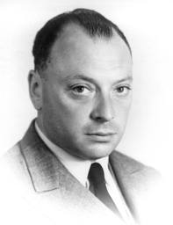
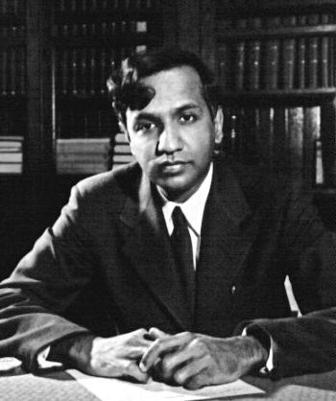
Chandrasekhar limit
Degenerate pressure (P_{d} ) of electron due to Pauli's exclusion principle will resist the contraction of the white dwarf and explode into small pieces, this known as super nova F_{G} < F_{P} + P_{d}
VS
If mass of the mass supernovae pieces more then the 1.4 times of solar mass (M =1.4M₀) then it can not maintain is white dwarf state,

Slide 21
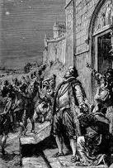
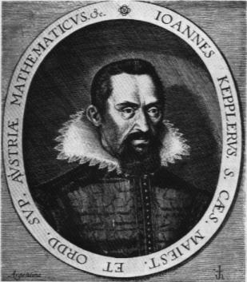
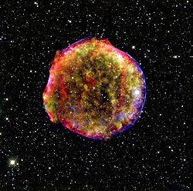
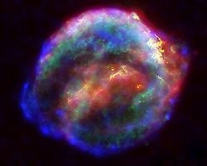
5.Supernova
Remnant of Kepler's Supernova, SN 1604
Remnant of Tycho brahe 's Nova, SN 1572

Slide 22
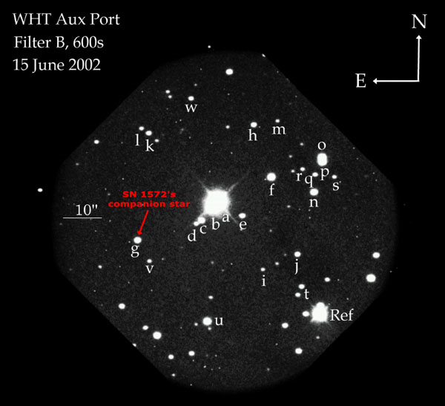
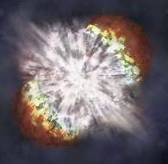
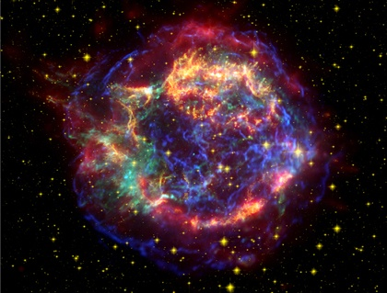
Supernova-photos

Slide 23
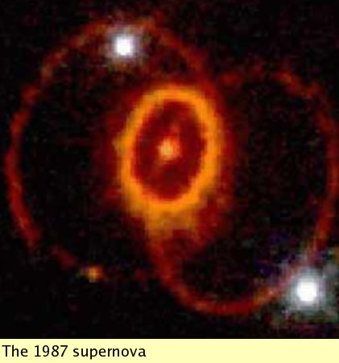

Slide 24
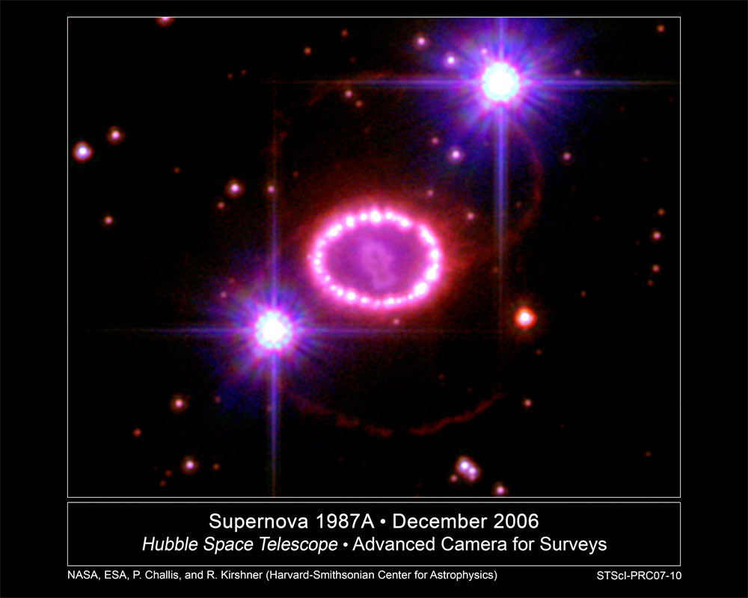

Slide 25
Remnant of supernova
A. Upto 1.4 M₀
White draft
B. above 1.4 to 3.2 M₀
Neutron star
C. Above 3.2M0
Black holes

Slide 26
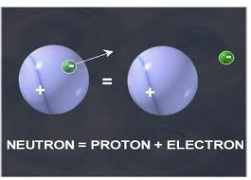
6. Neutron Stars
*A neutron star is a type of stellar remnant that can result from the gravitational collapse of a massive star during a supernova event.
*Such stars are composed almost entirely of neutrons.
*Neutron stars are very hot and are supported against further collapse because of the Pauli exclusion principle,
*Mass = 1.5 to 2.1 solar masses,Radius = 12 km, Escape velocity of around 100,000 km/s (about 33% of the speed of light), Temperature 10¹¹ to 10¹² K
*Density = 10¹⁶ − 10¹⁸ kg/m³ (This density is approximately equivalent to the mass of the entire human population compressed to the size of a sugar cube)
*surface gravity up to 7 × 10¹² m/s² with typical values of a few × 10¹² m/s² (that is more than 10¹¹ times of that of Earth)

Slide 27
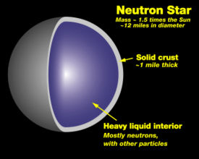
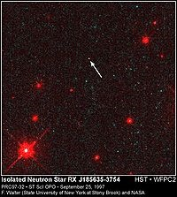

Slide 28



Pulsars (Spinning Neutron Stars)
In 1967 Jocelyn Bell and her teacher Anthony Hewish discover rapidly pulsating radio sources . Called "Pulsars" = Pulsating Radio Sources
Pulsars emitted sharp pulses at an extremely repeatable rate 1.4 ms to 30 seconds
Anthony Hewish got 1974 Nobel Prize for Physics for his role in the discovery of pulsars.

Slide 29


7.Black holes
A black hole is a super dense object that has an intense gravitational pull from which nothing, not even light can escape.
There are two parts to a black hole, a singularity and a event horizon. If you were to take a slice of a black hole right through its center it would look like this:
Density =4 × 10¹⁷ kg/m³
Mass = more then 3.4 M₀
Radius = 2km ( 3 times smaller then the neutron star)
Escape velosity = More then the speed of light

Slide 30




in 1916 Schwarzschild radius of black holes

Slide 31


Slide 32



How to detect the black holes?

Slide 33


Chandra telescope

Slide 34


Hawking radiation
* black hole of one solar mass has a Hawking temperature of about 100 X10⁻⁹ K
(This is far less than the 2.7 K temperature of the cosmic microwave background)
* If a black hole is very small the radiation effects are expected to become very strong. Even a black hole that is heavy compared to a human would evaporate in an instant.
* A black hole the weight of a car would only take a nanosecond to evaporate,

Slide 35



Slide 36



Slide 37

Ejnar Hertzsprung- Henry Norris Russell-Diagram
*A graph of the absolute magnitude of stars plotted against their surface temperature or color,
*used in the study of stellar evolution.

Slide 38



Ejnar Hertzsprung- Henry Norris Russell-Diagram

Slide 39
THANK YOU
Professor .K.Ravikumar
Ravikumark.phy@gmail.com
Cell :9840607391
Notes:
<number>

